Slide 1
New York City
October 2017
Notes:
On this visit to New York City, I took the bus to the Port Authority and then the subway to the Stanton Island Ferry/Battery Park stop.

Slide 2
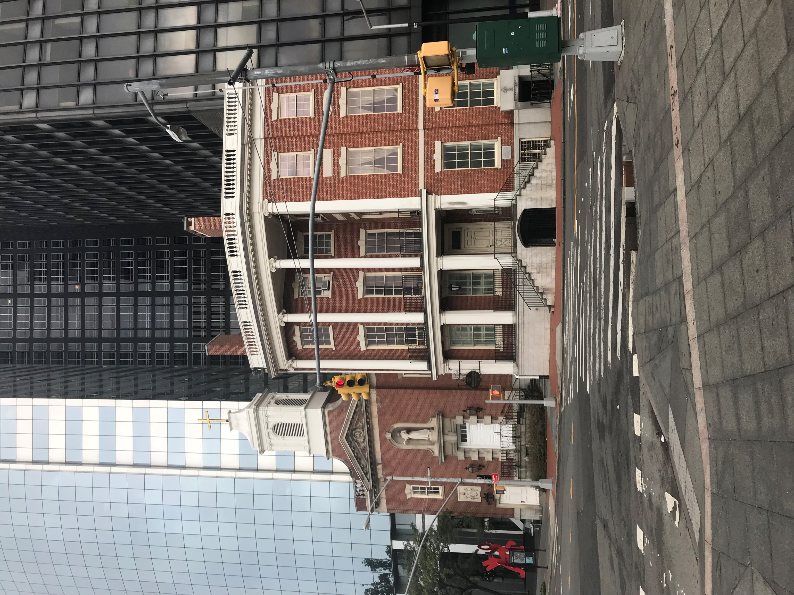
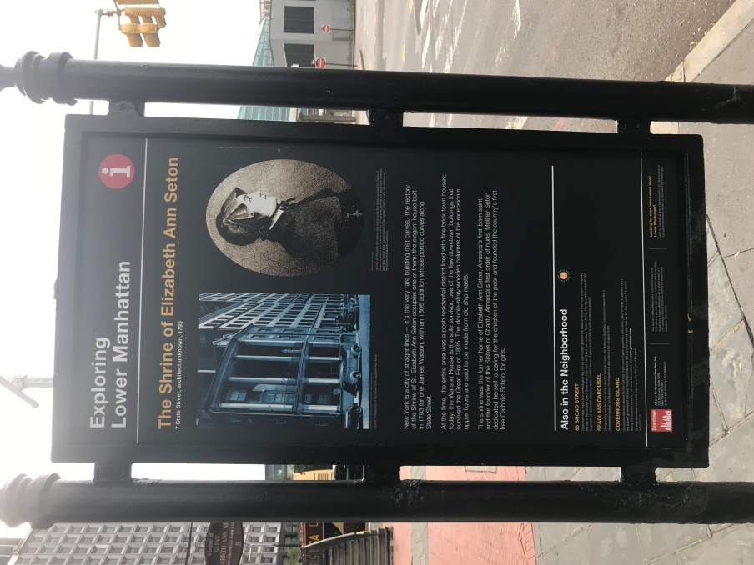
Shrine of Saint Elizabeth Ann Seton: First American-born Saint
Notes:
I walked around the area a little and I first saw this church, one of the only curved buildings in New York City, which stands on one of Manhattan’s southernmost streets, State Street. It is the National Shrine of St. Elizabeth Ann Bayley Seton. I didn’t know what about the church or Saint Seton. Trip Advisor: https://www.tripadvisor.com/Attraction_Review-g60763-d1226110-Reviews-Shrine_of_St_Elizabeth_Ann_Bayley_Seton-New_York_City_New_York.html and The Shrine of St. Elizabeth Ann Seton: https://www.atlasobscura.com/places/the-shrine-of-st-elizabeth-ann-seton some background information.
The shrine was the former home of Elizabeth Ann Seton. Today it is the rectory for the church next-door, Our Lady of the Holy Rosary.
The church was originally established as a mission for the protection of Irish immigrant girls.
Today the church serves lower Battery Park City as well as Financial City residents and workers. The building was first built for James Watson in 1793 and an addition whose portico curves along State Street was build in 1806. The parish was established in 1886. It is one of the only buildings left downtown that survived the Great Fire of 1835. The white double-story wooden columns are said to be made from old ship masts.
Saint Seton was born in New York City around 1774. She is the founder of the order of The Sisters of Charity, America’s first order of nuns. She founded the first free Catholic School for girls and began the Catholic parochial schools system in the United States. It was especially interesting to me because I taught with the Sisters of Charity at a Catholic school in Lawrence, Kansas, years ago.

Slide 3
Battery Park
Notes:
Across from the Elizabeth Ann Seton Shrine is Battery Park.

Slide 4
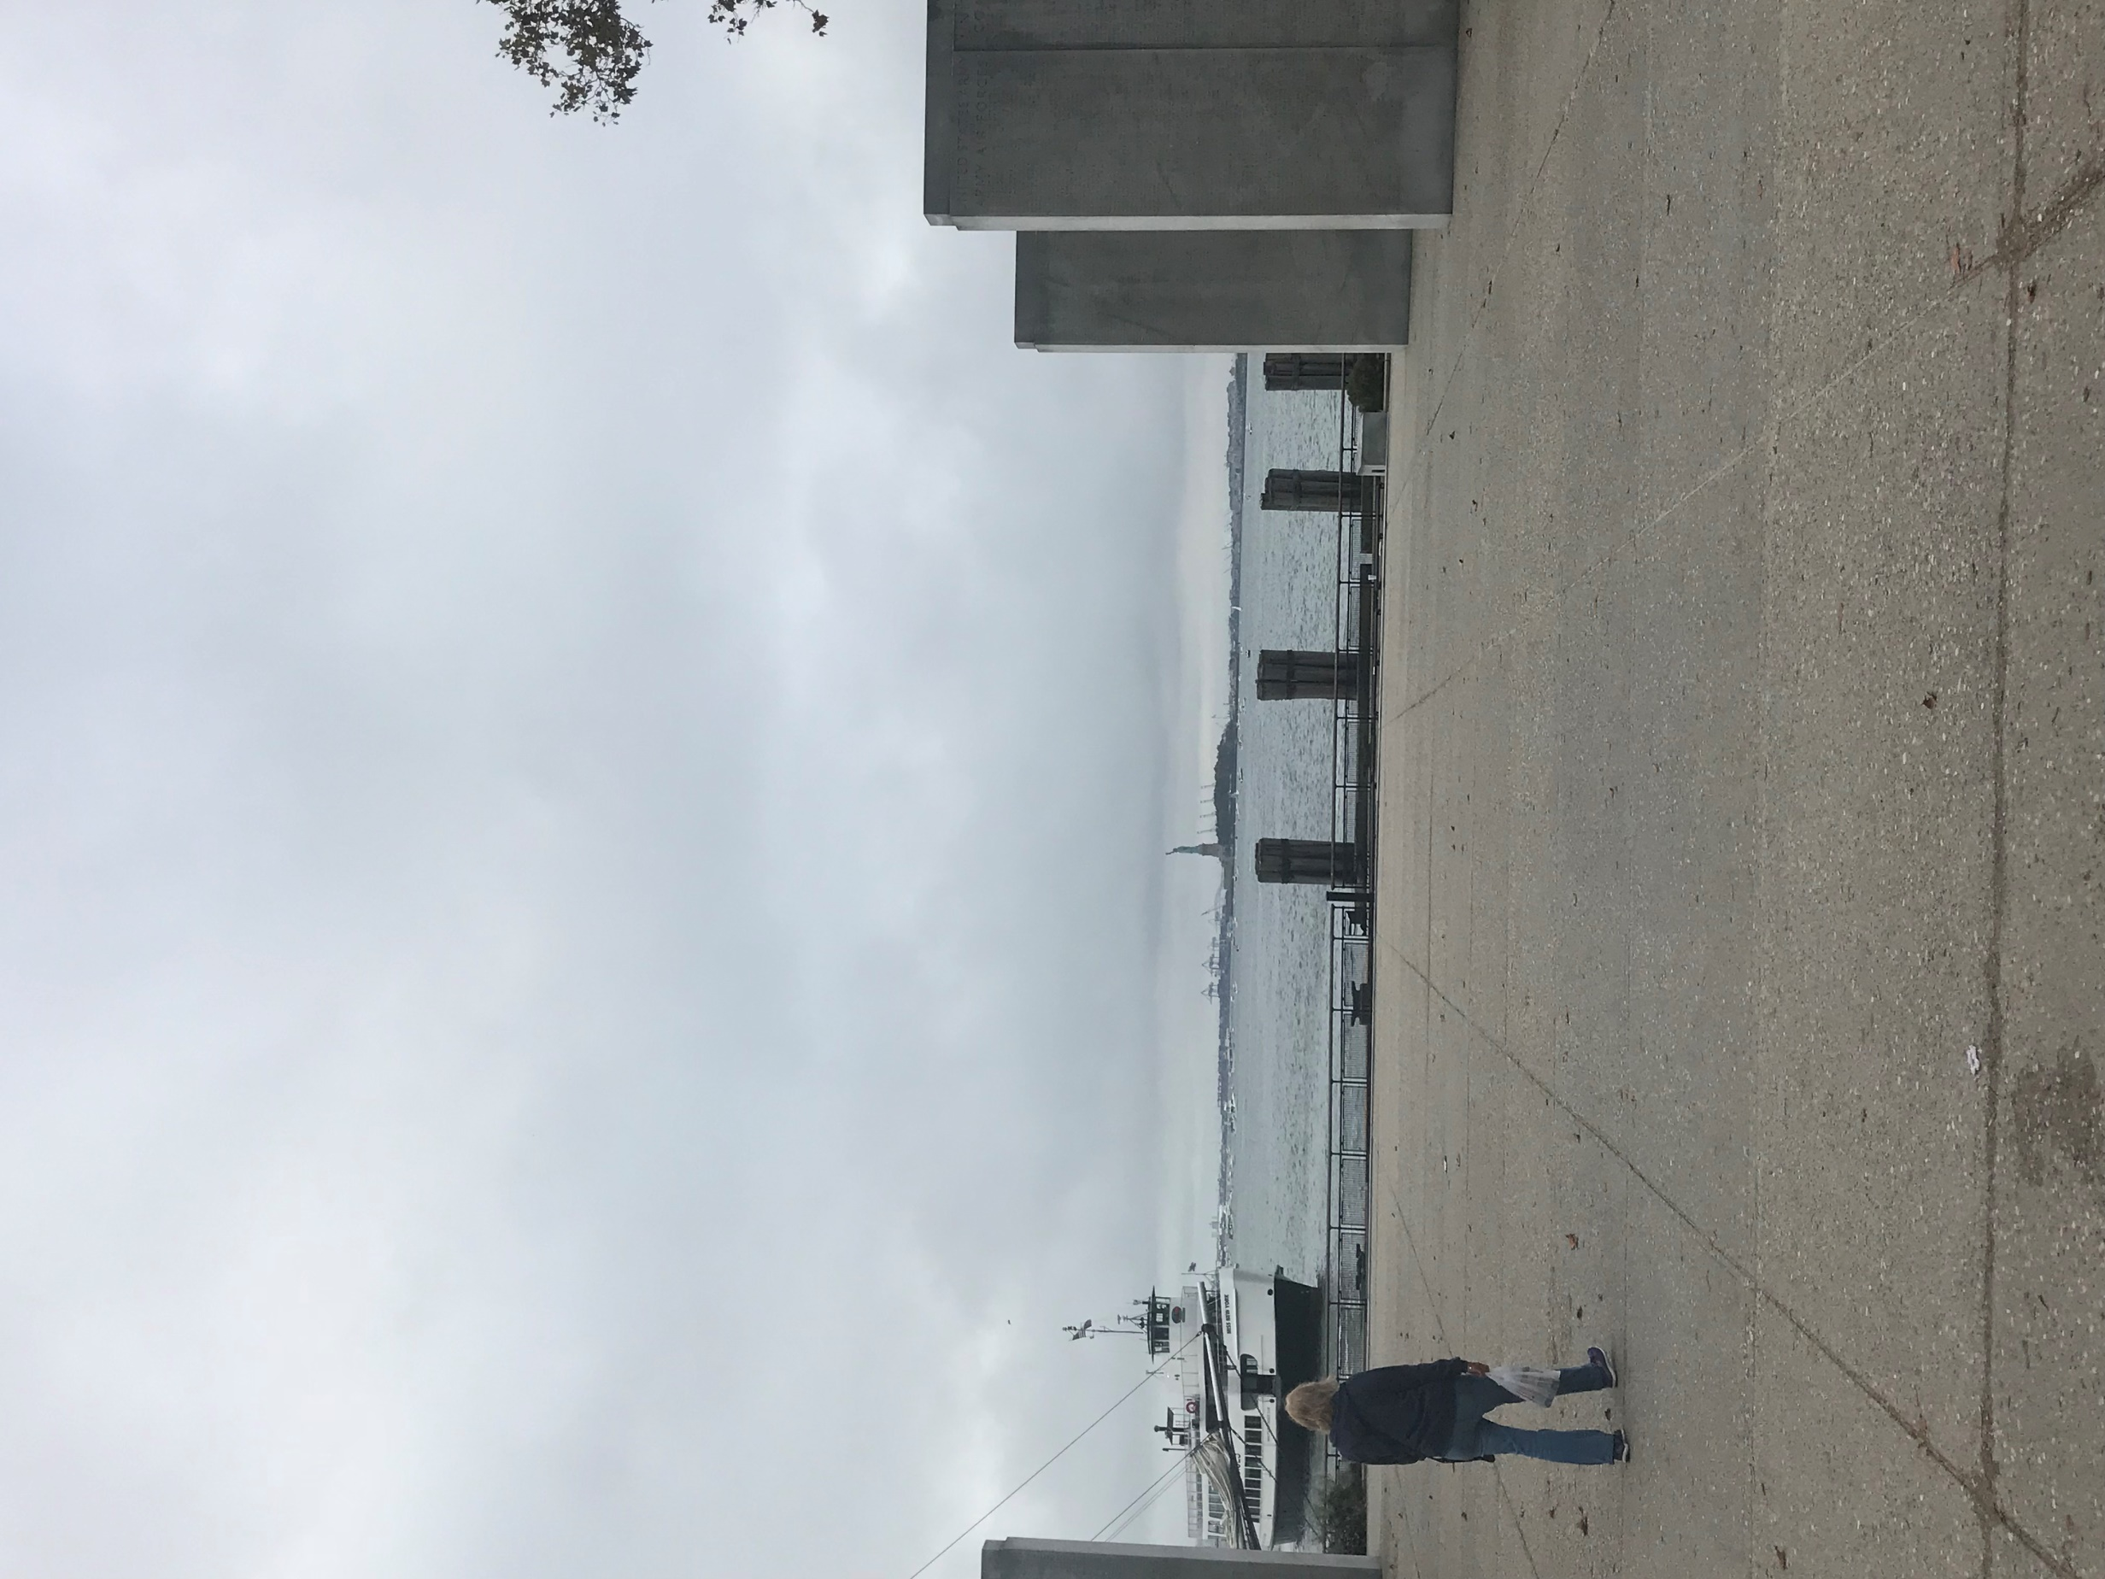
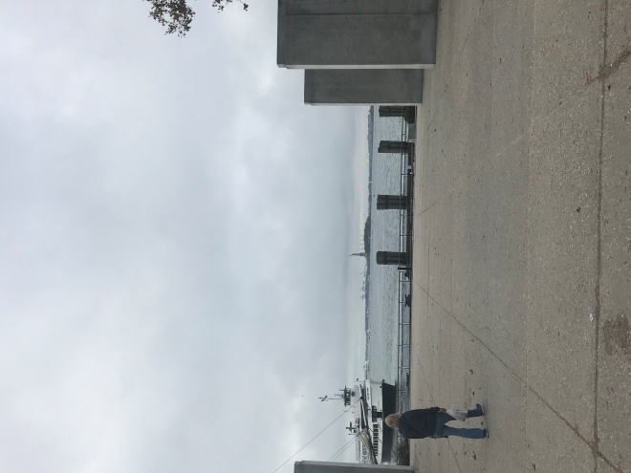
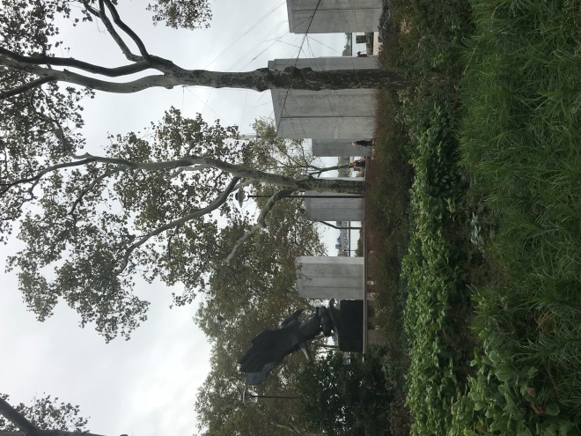
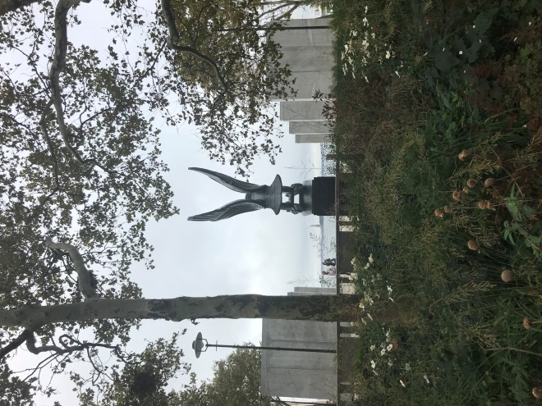
East Coast WWII Memorial
Notes:
At the south end of Battery Park, facing the Statue of Liberty, is the East Coast Memorial. It honors the 4,601 missing American servicemen who lost their lives in the Atlantic Ocean while engaged in combat during World War II. A bronze eagle was sculpted by Albino Manca and sits on a pedestal of polished black granite. The eagle is gripping a laurel wreath over a wave. This signifies the act of mourning at the watery grave.
The eagle sculpture is between two ranks of four 19 foot⁽²⁾ inscribed pylons, eight pylons in all. The axis of the pylons are aligned with the Statue of Liberty.⁽¹⁾ The pylons contain the name, rank, military branch and home state for each soldier. ⁽²⁾
The inscription on the front of the pedestal says:
1941***1945
ERECTED BY THE UNITED STATES OF AMERICA
IN PROUD AND GRATEFUL REMEMBERANCE
OF HER SONS
WHO GAVE THEIR LIVES IN HER SERVICE
AND WHO SLEEP IN THE AMERICAN COASTAL WATER
OF THE ATLANTIC OCEAN
INTO THY HANDS, OH LORD.
The back of the pedestal says:
1941***1945
IN ADDITION TO THE 4,597 AMERICAN SERVICEMEN HONORED HERE
WHO LOST THEIR LIVES IN HER SERVICE AND WHO SLEEP IN THE AMERICAN COASTAL WATERS OF THE ATLANTIC OCEAN
THE UNITED STATES OF AMERICA HONORS THE 6,185 SEAMEN OF THE UNITED STATES MERCHANT MARINE
AND THE 529 SEAMEN OF THE UNITED STATES ARMY TRANSPORT SERVICE
WHO LOST THEIR LIVES DURING WORLD WAR II.⁽¹⁾
Sources:
(1)https://www.nycgovparks.org/parks/battery-park/monuments/1929,
(2) http://www.aviewoncities.com/nyc/eastcoastwarmemorial.htm

Slide 5
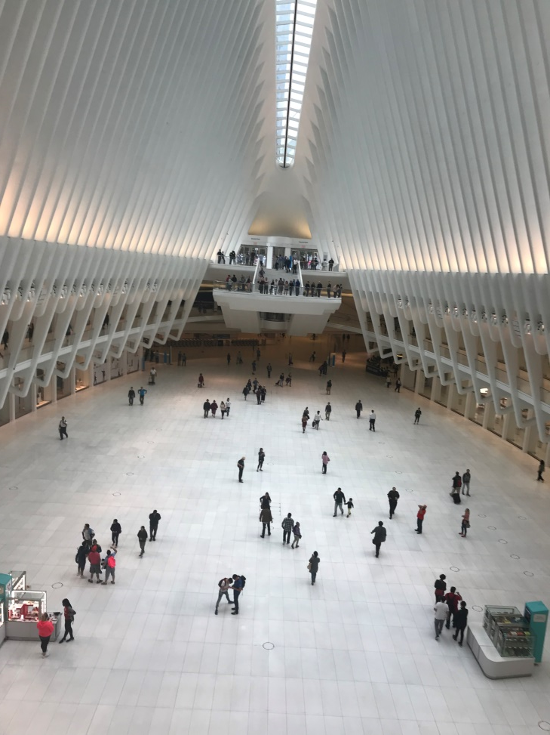
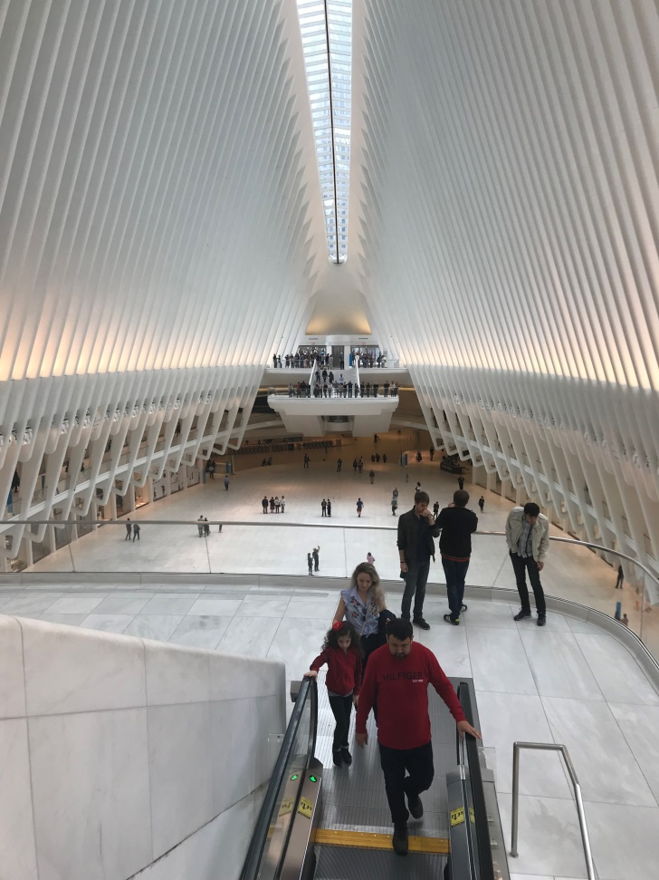
World Trade Center
Notes:
From Battery Park it is an easy walk to the new World Trade Center. We entered the Transportation Hub at street level and then took the escalator down to the subway.
More information at: https://wtc.com/

Slide 6
Columbus Park
Notes:
We left the subway to visit Columbus Park, one of the city’s first major urban parks, which is situated in the heart of one of the oldest residential areas in Manhattan. I was particularly interested in this park because it until 1808 the site was a swampy area near the Collect Pond where the first European settlers got their water. “In 1808 the pond was filled and became Pearl Street. When the filling began to sink, a foul odor emerged which depressed the living conditions of that neighborhood. As a consequence, the area became host to one of the world's most notorious tenements, known for its wretched living conditions and rampant crime, earning such names as “murderer's alley” and “den of thieves.”…Immigrants used Five Points as a stepping stone to a better life in a new land and nowadays, one can view the area not as a wretched slum but as a microcosm of the young city’s burgeoning and complex demographic. … In the 20th century, the area around Five Points was subsumed by sprawling Chinatown, with the latest generation of immigrants beginning to create a new life afresh in Manhattan’s historic downtown.”
Information from: https://www.nycgovparks.org/parks/columbus-park-m015/history

Slide 7
Nom Wat Tea Parlor
Notes:
We ended the day by eating at the Nom Wah Tea Parlor. There was a line but the food was worth the wait! The restaurant has authentic early 20th century dim sum which we sampled.⁽¹⁾
The Nom Wat Tea Parlor is located on what was called “Bloody Angle” on Doyers Street. It is between Pell and Mott and has one of the most crooked histories in town. “Neutral ground for the feuding On Leong and Hip Sing Tongs, Doyers has been the site of more than one full-scale king-fu rumble.”⁽²⁾
Information from:
(1) http://nomwah.com/chinatown/
(2) https://infamousnewyork.com/tag/nam-wah-tea-parlor/

